Slide 1


Understanding Open Ports in Android Applications: Discovery, Diagnosis, and Security Assessment
Daoyuan Wu¹, Debin Gao¹, Rocky K. C. Chang²,
En He³, Eric K. T. Cheng², and Robert H. Deng¹
¹
²
³
China Electronic Technology Cyber Security Co., Ltd.
Notes:
Good afternoon, I am very excited to be here to present our work, … I am Daoyuan Wu, a PhD candidate from … This is a joint work with Debin and Robert from SMU, …

Slide 2





http://127.0.0.1:1234//filename
Open port
Inject dangerous commands
Notes:
Mobile apps reside in the client-side smartphones. They send traffic to remote servers for data communication. But could you imagine that many Android apps also contain open ports. A port is regarded as open if it is listening for incoming packets and potentially responds to them. However, such port opens a new door for adversary to launch attacks, for example, stealing private files through HTTP request, and injecting dangerous commands for execution.

Slide 3

The First Step: Discovering Open Ports in Apps
Static Analysis
In-lab Dynamic Analysis
OPAnalyzer [EuroS&P’17]
Cannot mimic real user inputs to driven apps
Crowdsourcing
Discovery
Issues:
dynamic code loading, complex implicit flows,
and code obfuscation.
Difficult to recognize random port numbers
Leverage users’ interaction with their smartphones to monitor open ports
Notes:
To systematically understand open ports in Android apps and their threats, the first step is to discover them. Static analysis, was taken by a previous work for automatic vetting of open ports. However, typical Android static analysis cannot handle … Dynamic analysis have no such issues but the traditional in-lab dynamic analysis cannot mimic real user inputs to trigger open ports. It also cannot differentiate fixed and random port numbers across different devices. In our work, we propose a crowdsourcing-based approach, which leverages users’ interaction with their smartphones to monitor open ports from each individual phone in the wild.

Slide 4
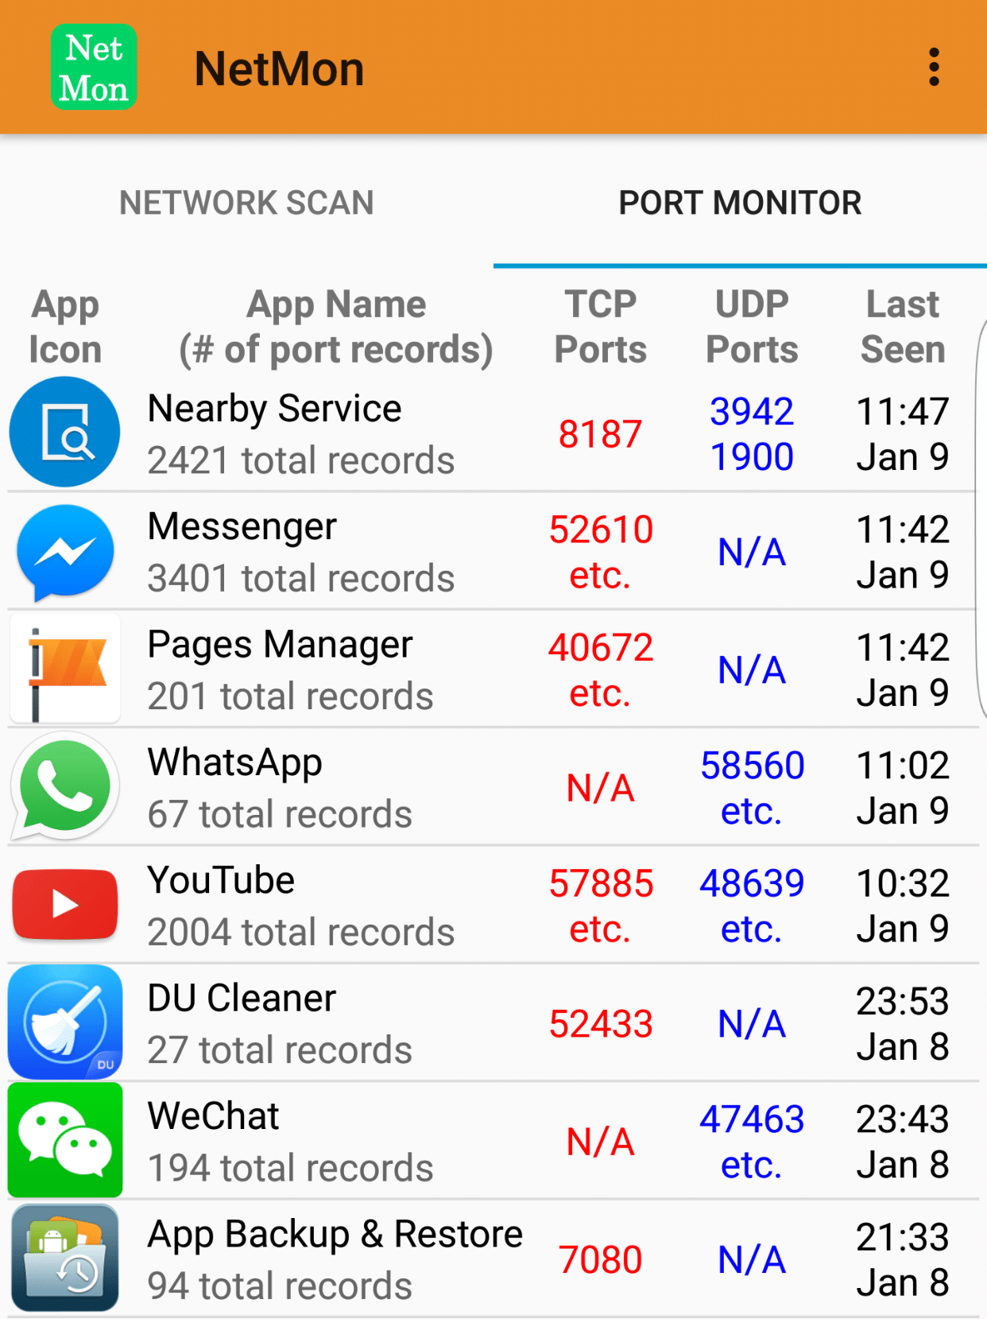
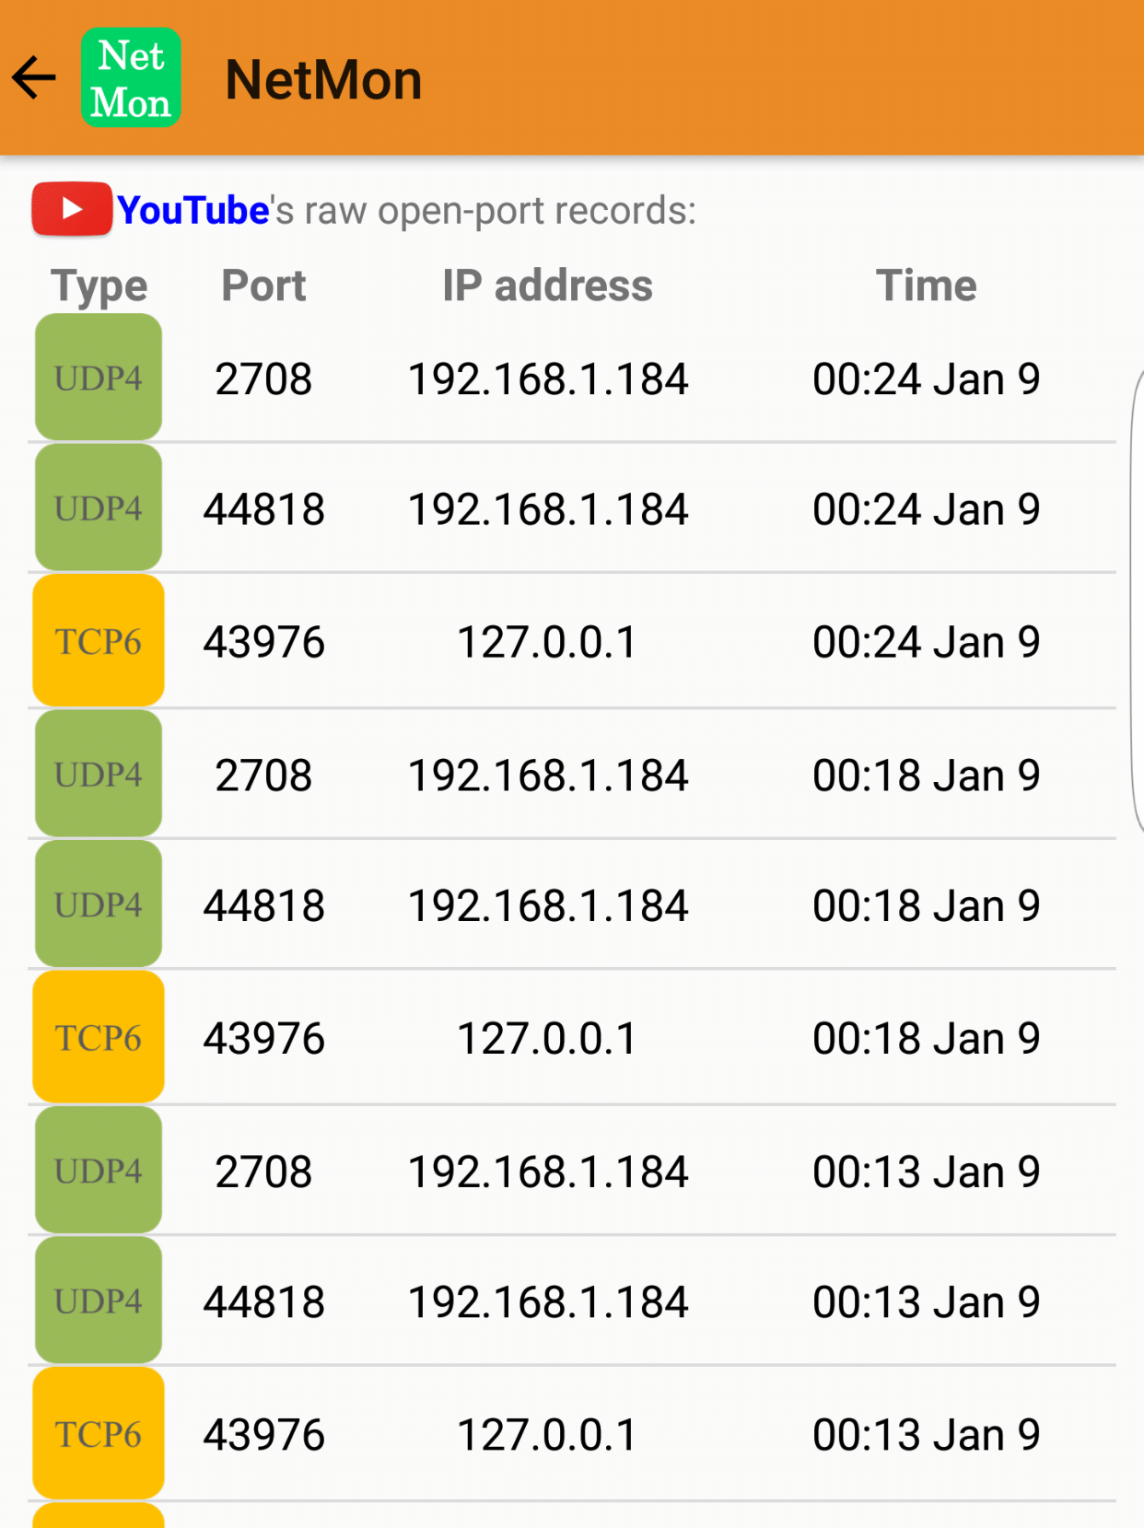
NetMon: On-device Open Port Monitoring
Available on Google Play since October 2016
https://play.google.com/store/apps/details?id=com.netmon
Notes:
We have designed and deployed a crowdsourcing app called NetMon, for on-device open port monitoring. Here shows its two major user interfaces, where you can see it can capture open ports from other applications. We also show detailed monitoring records to our users. !!! Nearby port …

Slide 5

Port Monitoring Mechanism
$ cat /proc/net/tcp6 (accessible also on the latest Android 8 and 9)
sl local_address remote_address st tx_queue rx_queue tr tm->when retrnsmt uid
0: 0000000000000000FFFF00000100007F:9AE0 00000000000000000000000000000000:0000 0A 00000000:00000000 00:00000000 00000000 10156
1: 0000000000000000FFFF00000100007F:EC22 00000000000000000000000000000000:0000 0A 00000000:00000000 00:00000000 00000000 10272
2: 0000000000000000FFFF00002600040A:E8EA 0000000000000000FFFF00006B72662F:01BB 06 00000000:00000000 03:00001279 00000000 0
3: 0000000000000000FFFF00002600040A:84B0 0000000000000000FFFF00005FC2D9AC:01BB 08 00000000:00000001 00:00000000 00000000 10015
/proc/net/tcp |tcp6|udp|udp6

p
p
Periodically analyze proc with minimal overhead
Notes:
So how exactually NetMon can monitor other apps’ open ports without the root permission? Directly probing them is infeasible on Android due to the app sandbox. Fortunately, there is a side interface on the proc files that provides with us the socket table in the kernel space. Here we show its several sample rows, where you can pinpoint open ports through a special socket status, 0A, and identify the corresponding app with UID, and further extract IP address and port number. Note that these TCP and UDP proc files are accessible on all Android, including the latest Android 8 and 9. In real deployment, we need to periodically monitor those four proc files because there is no mechanism to notify us when the content gets changed. In the paper, we also mention several mechanisms we have leveraged to minimize the overhead of such periodic monitoring.

Slide 6
Server-side Open-Port Analytic Engine
UID | App | Type | IP | Port | Time
U1 | Netflix | UDP4 | 0.0.0.0 | 1900 | T1
U1 | Netflix | UDP4 | 0.0.0.0 | 39798 | T1
U2 | Netflix | UDP4 | 0.0.0.0 | 1900 | T2
U2 | Netflix | UDP4 | 0.0.0.0 | 32799 | T2
……
Ux | Netflix | TCP4 | 0.0.0.0 | 9080 | Tx
Uy | Netflix | TCP4 | 0.0.0.0 | 9080 | Ty
App | Type | IP | Port
Netflix | TCP4 | 0.0.0.0 | 9080
Netflix | UDP4 | 0.0.0.0 | 1900
App | Type | IP | Port
Netflix | UDP4 | 0.0.0.0 | Random
Raw port monitoring records
“Intelligent”
engine
Per-app open ports
Notes:
Compared to other app-based crowdsourcing, there is a unique challenge in our open-port crowdsourcing. That is, the collected raw records cannot be directly analyzed because they are just individual observations while we must know per-app open port results for the analysis. For example, we need to tell Netflix has two fixed ports which are recognized from these records. It also has a random UDP port that is unified from these different records. This might look obvious here to a human, but when you face millions of records and require a machine to process them, we need an ... to automatically cluster raw monitoring records to per-app open ports.

Slide 7
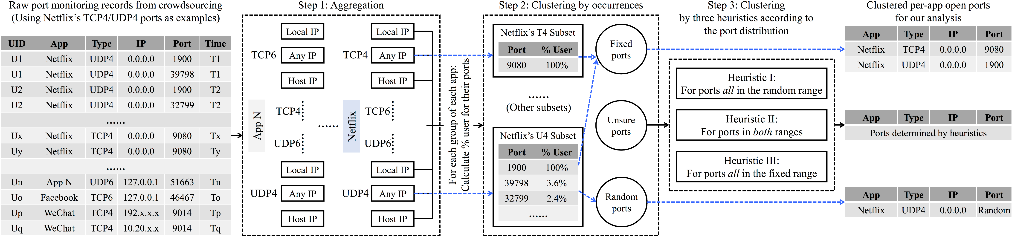
Server-side Open-Port Analytic Engine
Notes:
Our analytic engine performs a three-step clustering. First, we aggregate raw records into different groups according to IP address and port types.
In each group of a given app, we further calculate the user percentage associated with each port number. A high … indicates a fixed port, while …
However, there are still some undetermined ones in between the low and high percentage. Therefore, we propose … to further classify them.

Slide 8
Crowdsourced Open Port Results
The ten-month data:
3,293 user phones from 136 different countries
26% are from US, while diverse for others
40M port monitoring records:
2,778 open-port apps
And their 4,954 open ports
The effectiveness:
Discovered 2,284 apps with TCP open ports, vs. 1,632 apps detected in state-of-the-art research [EuroS&P’17].
In a controlled set of apps with TCP open ports, 25.1% of them use dynamic or obfuscated codes for open ports.
The pervasiveness:
Correlated with top 3,216 apps from Google Play, 492 of them are with open ports.
Pervasiveness: 15.3%.
Notes:
We have deployed NetMon to Google Play for an IRB-approved crowdsourcing study and have collected a large-scale crowdsourcing dataset.
In the paper, we report the ten-month data which includes 40M port monitoring records from more than 3K users. In particular, we discovered more apps with TCP open ports as compared to the previous work that already used a large app set for static analysis, let alone the UDP open ports they didn’t cover at all. Moreover, we showed that up to 25% apps used dynamic or obfuscated codes for the open-port functionality. To further quantify the pervasiveness of open ports in popular apps, we correlated our crowdsourcing results with top 3K apps and found the pervasiveness is around 15%.

Slide 9
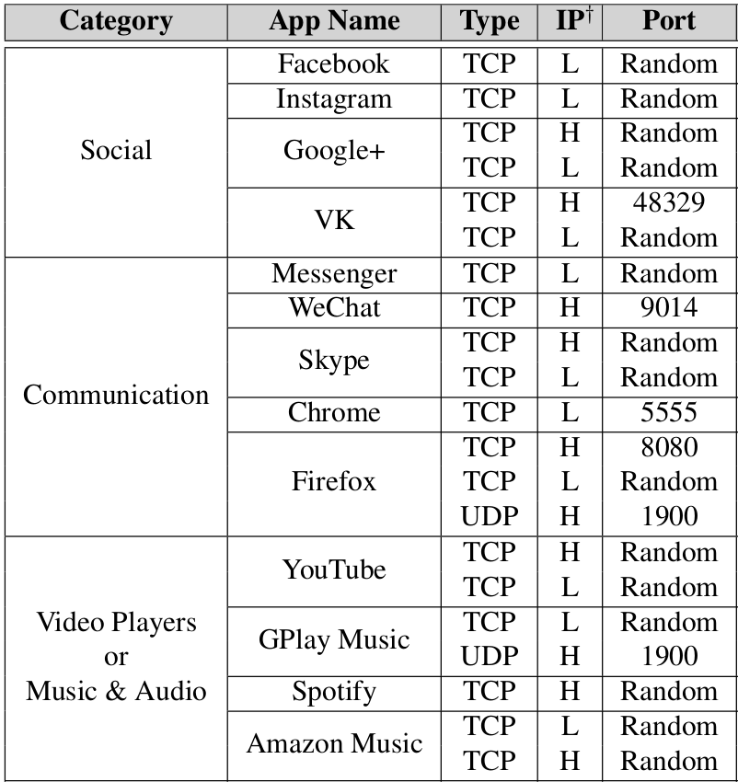
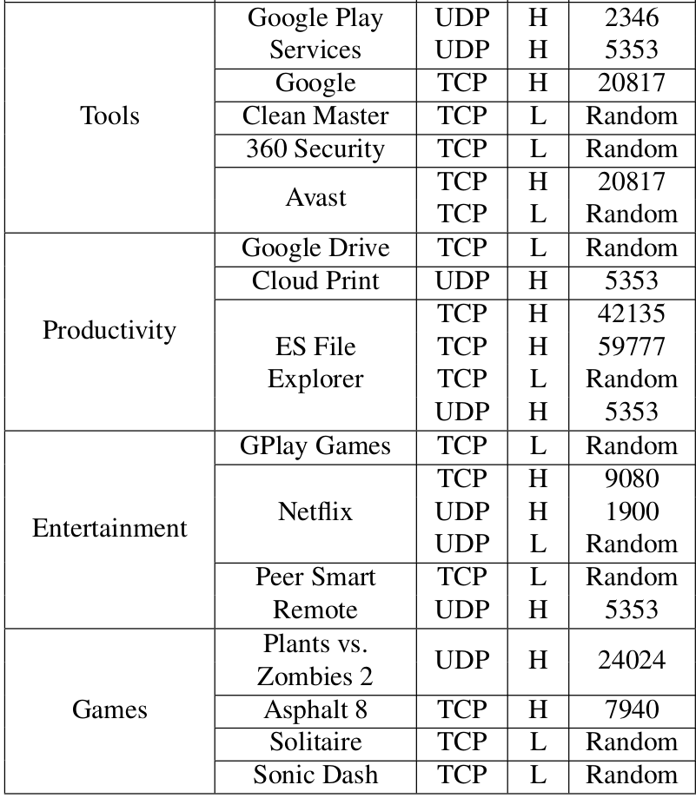
Open Ports in 925 Popular Apps
Notes:
In particular, we have identified open ports in a large number of popular apps that has one million installs each. Here lists 28 representative open-port apps from different categories…
You can see that some high-profile apps such as Facebook and Instagram are also not free of open ports.

Slide 10
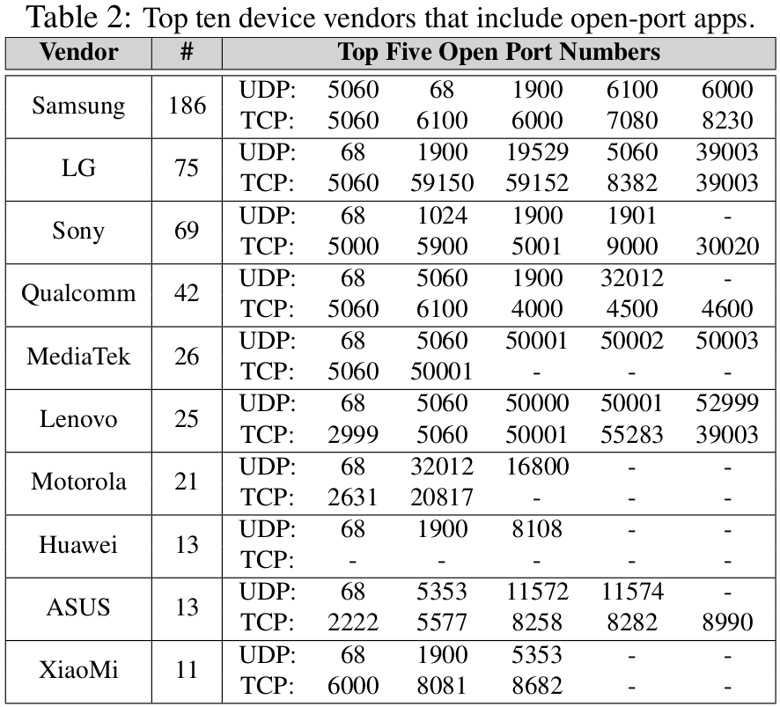
Open Ports in 755 Built-in Apps
More than half of these built-in apps contain UDP open port 68.
One quarter (175 apps, 23.2%) have TCP/UDP port 5060 open.
41 Samsung and 16 LG models modify some Android AOSP apps to introduce port 5060.
TCP port 6000 in Xiaomi Browser
UDP port 19529 in LG’s 18 apps

Slide 11
While crowdsourcing is effective in discovering open ports, it does not reveal the code-level information for more in-depth understanding or diagnosis.

Slide 12
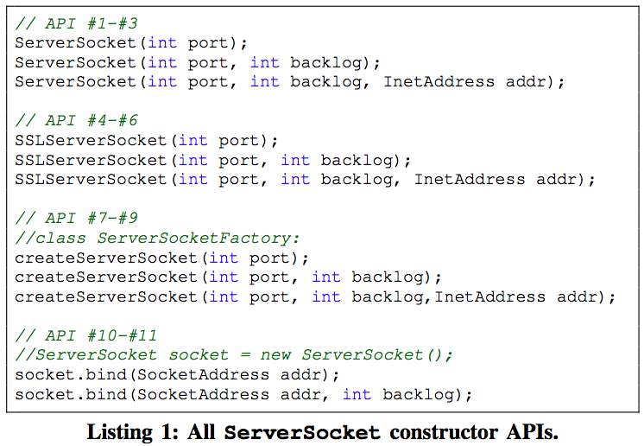
Open Port Diagnosis via Static Analysis
SDK?
Insecure parameters?
2
1
Notes:
Therefore, we further perform static analysis to understand how open ports are actually constructed at the code level and its security implication.
Specifically, given a ServerSocket API call, we have two objectives. First, we want to trace the entire hierarchy to determine whether an open port is actually introduced by SDKs. Second, we further perform dataflow analysis to diagnose insecure parameters.

Slide 13
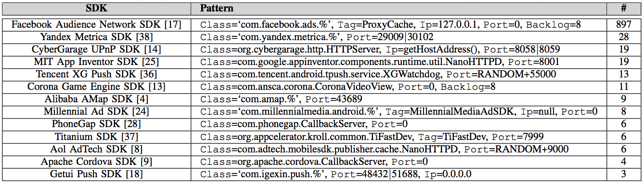
Diagnosis I: Open-Port SDKs
Out of the 1,520 open-port apps:
61.8% are solely due to SDKs; Facebook SDK is the major contributor.
13 open-port SDKs detected:
Notes:
Out of this number of TCP open-port apps analyzed, we found that .
Totally, we detected 13 open-port SDKs as shown in this table.

Slide 14
Diagnosis II: Insecure API Usages
Did not set the IP addr param or set it “null”.
581 apps whose open ports are not introduced by SDKs
611 open ports from 390 apps (67.1%) adopted “convenient” API usages
164 ports from 120 apps (20.7%) set their port number param random
20.7% (120/581) open-port apps adopt convenient but insecure API usages.

Slide 15
In the last phase of our pipeline, we perform three novel security assessments of open ports.
Notes:
We further perform ...

Slide 16
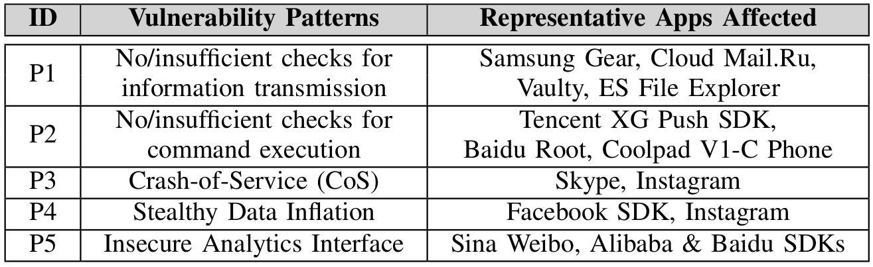
Vulnerability Patterns Identified in Open Ports
Terminate on-going sessions by sending two UDP packets
Crash Instagram by sending just a HTTP request
Some open ports are used as an analytics interface for their companion websites.
Send a HTTP URL request pointing to a large file, to maliciously inflate victim apps’ cellular data usage in the background.
Notes:
I have already mentioned the first two in the beginning slides. For the third one, it is a new variant of the traditional app crash, which does not rely on application-level data. For example, we can simply crash … We further develop a new vulnerability pattern called …. In this that sends a …, in order to maliciously …
Furthermore, some open ports … However, such analytic open port in fundamentally insecure because any connecting party can set the correct HTTP referrer to bypass the checking.

Slide 17
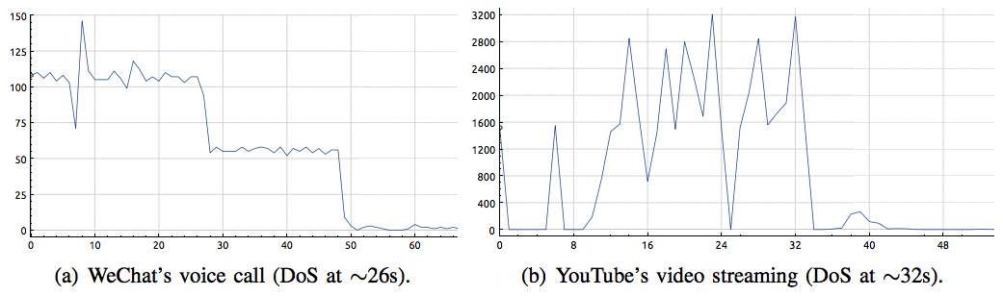


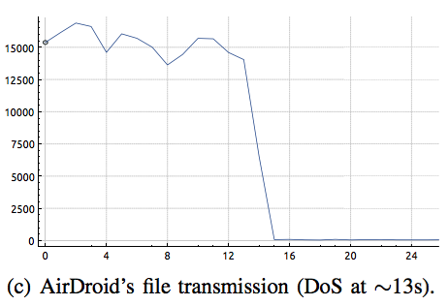

Denial-of-Service Attack Evaluation
Notes:
Besides individual vulnerabilities, we further demonstrated the effectiveness of a general denial-of-service attack against mobile open ports.
You can see here after DoS attack is launched, the throughput of WeChat’s voice call, Youtube’s drops significantly.

Slide 18
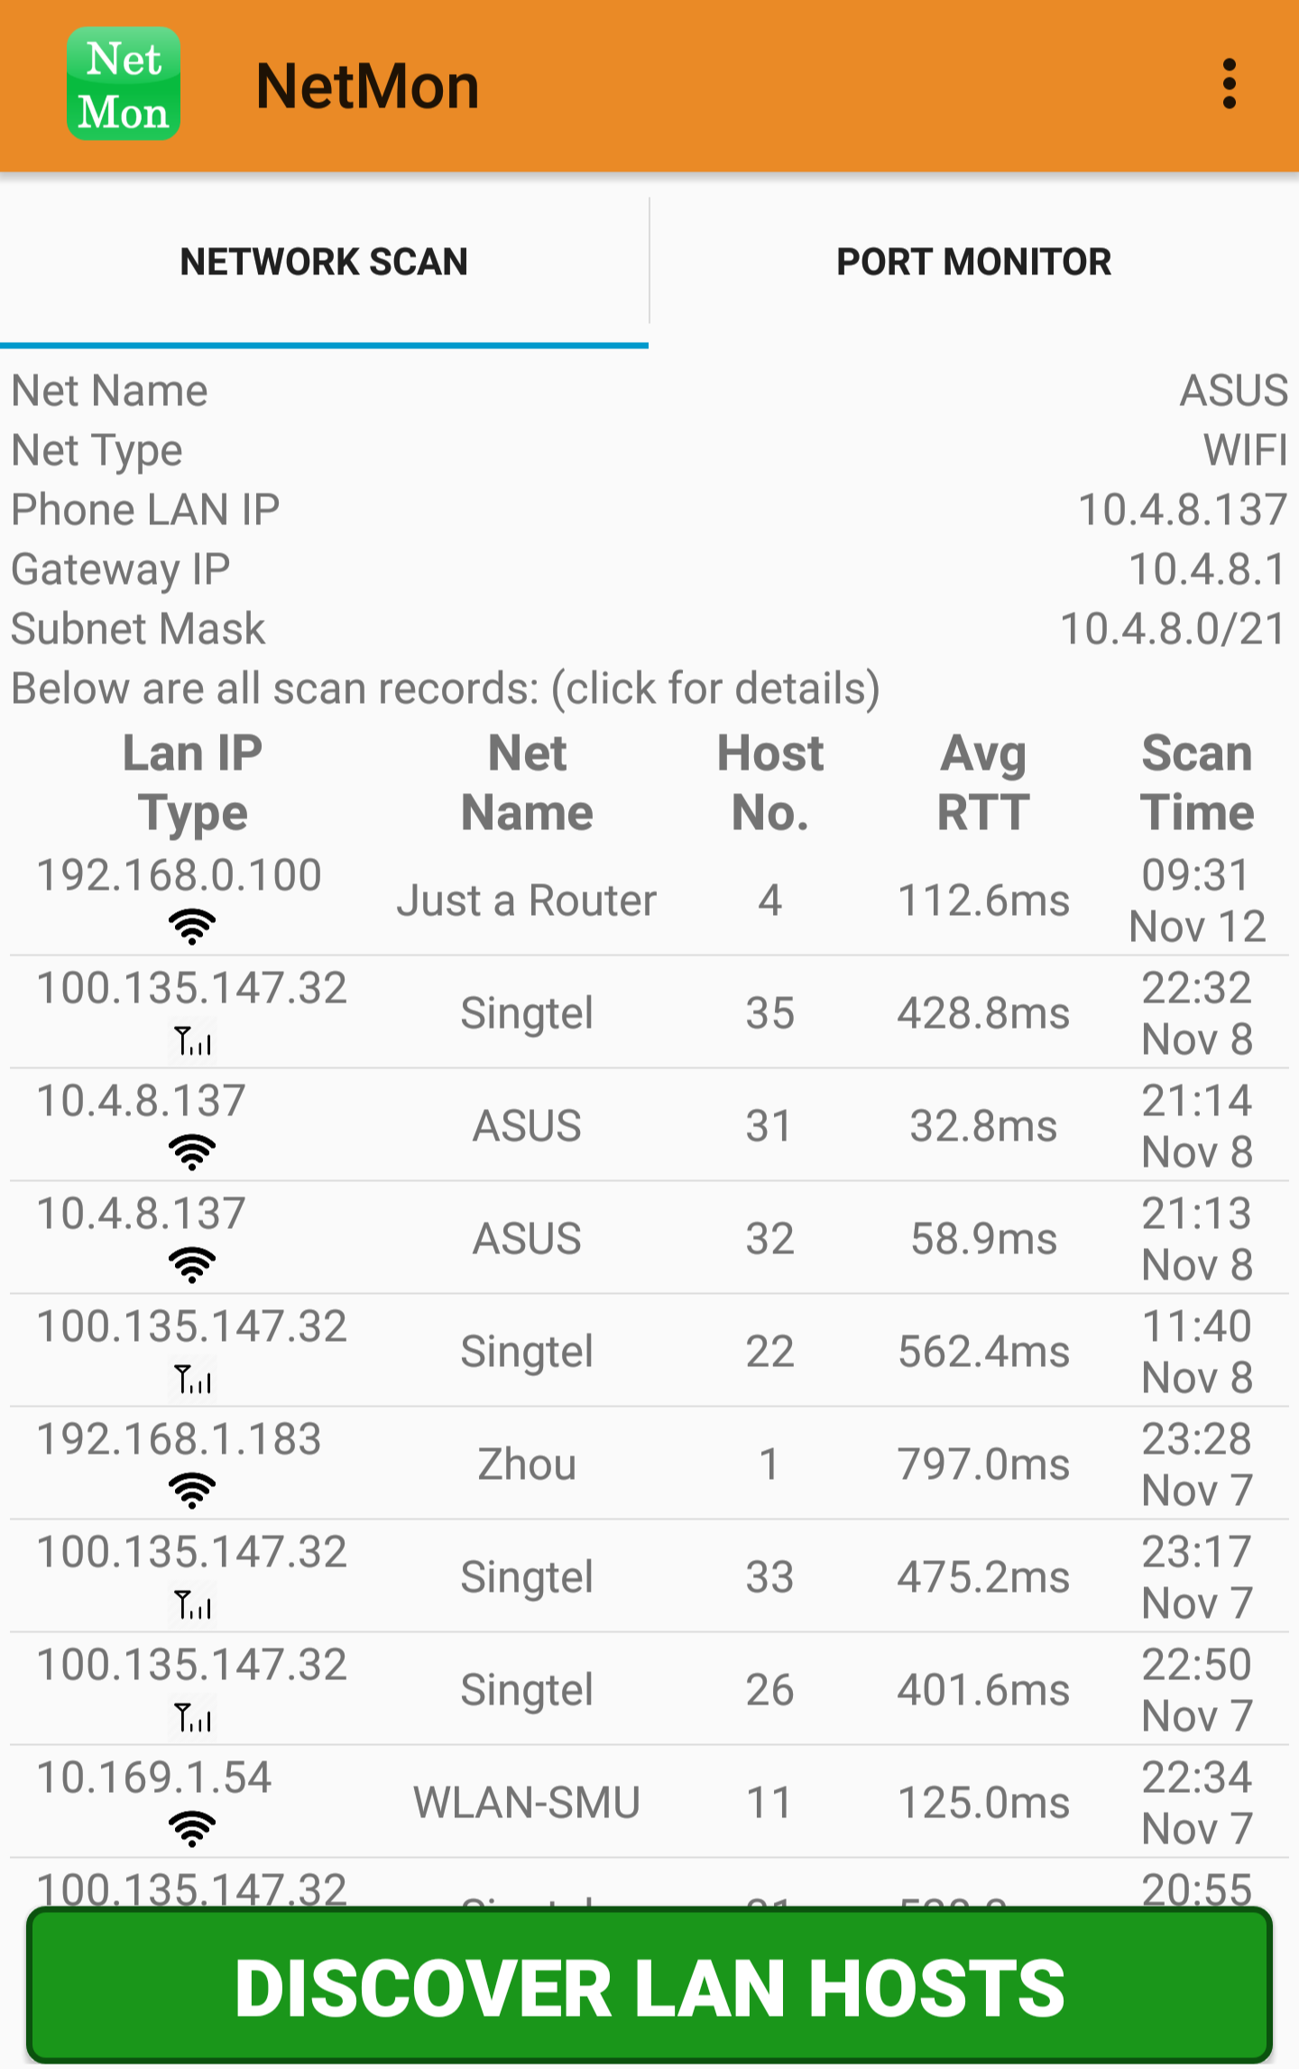
Inter-device Connectivity Measurement
Remote open-port attacks require the victim device to be connected (intra- or inter-network).
6,391 network scan traces
224 cellular networks
2,181 WiFi networks
111 (49.6%)
1,823 (83.6%)
Allow intra-network connectivity (in the same network)
23 cellular
10 WiFi
Allow inter-network connectivity due to using public IP
Notes:
In order to launch remote open-port attacks for the previous vulnerabilities and denial-of-service, a victim device must be … either in or even from ..
We therefore further leverage NetMon to test whether a device can connect to another in real user networks using Ping, TCP and UDP packets.
Totally we collected … from over

Slide 19
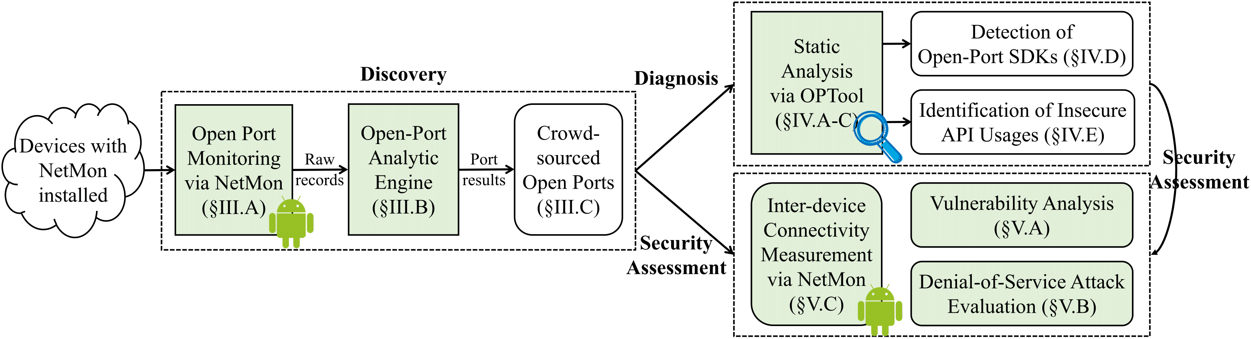
Conclusion & Takeaway
We proposed the first open-port analysis pipeline.
We found open ports in many popular and built-in apps, and also in SDKs.
We performed comprehensive security assessments:
Vulnerabilities in popular apps, DoS experiments, real connectivity measurement.
Contact: Daoyuan Wu dywu.2015@smu.edu.sg
Notes:
Here is the takeaway of my talk. First, that covers the open-port discovery, diagnosis, and security assessment.
Our crowdsourcing found …, and our diagnosis through static analysis further showed that a significant portion of TCP open ports are introduced by SDKs.
Thank you for listening. I am now ready to take your questions.

