Slide 1
Indirect File Leaks in Mobile Applications
MoST’15, in conjunction with S&P’15
Daoyuan Wu and Rocky K. C. Chang
The Hong Kong Polytechnic University
May 21, 2015

Slide 2
Prologue
Mobile apps are gaining significant popularity.
Much of sensitive user information is stored inside mobile apps.
  Facebook’s cookie files
  Evernote’s private notes
  Tencent QQ’s chat logs
Sandbox-based app isolation is employed to …
Notes:
Sensitive notes stored in Evernote,

Slide 3
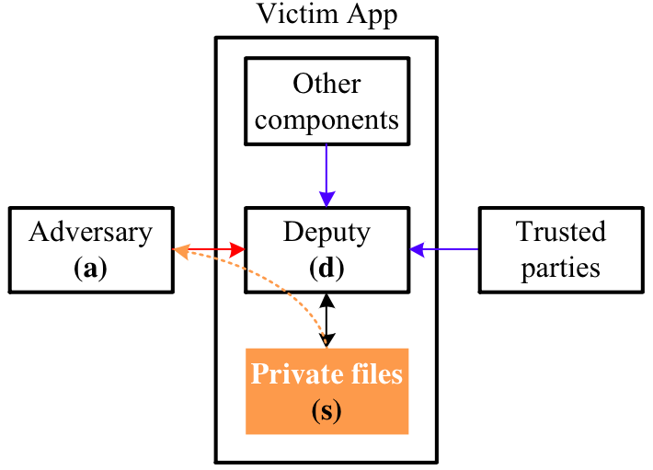
Indirect File Leak (IFL) attacks
Notes:
However, it is still possible for an adversary to steal private app files in an indirect manner by exploiting components that are trusted by the victim apps.

Slide 4
Contributions
Four new mobile IFL attacks
  Can affect both Android and iOS
  Are exploitable not only locally but also remotely
A number of zero-day IFL vulnerabilities
  In popular Android and iOS apps
  Also a serious SOP issue in the latest iOS 8 system
A comparison of Android and iOS’s susceptibility

Slide 5
An Overview of Our IFL Attacks
The sopIFL attacks
  Bypass the same-origin policy on browsing interfaces
The aimIFL attacks
  Execute unauthorized JavaScript directly on target files
The cmdIFL attacks
  Execute unauthorized commands on cmd interpreters
The serverIFL attacks
  Send unauthorized file extraction requests to embedded app server deputies

Slide 6
1. The sopIFL attacks
Via breaking the SOP enforcement on:
  http:// → file:// (SOPf1)
  file://a.html → file://b.txt (SOPf2)
Our prior work [47] showed that many Android browsers fail to enforce SOPf2.
Our this paper shows that even the latest iOS 8 does not properly enforce SOPf2 (also iOS 7).
[47] D. Wu and R. Chang. Analyzing Android browser apps for file:// vulnerabilities. In Proc. Springer ISC, 2014.

Slide 7
The root problem on SOPf2
The legacy SOP cannot adequately cover the local schemes, such as file://.
According to the typical web SOP principle,
  Legal for a file A (at file:///dir1/a.html) to access another file B (at file:///dir2/b.txt).
  Because the two origins share the same scheme, domain (i.e., 127.0.0.1 or localhost), and port.
But in practice,
  This legal behavior fails to meet the security requirements for file://, especially in the mobile env.
  We call for an enhanced SOP for local schemes, such as adding the “path” element.

Slide 8
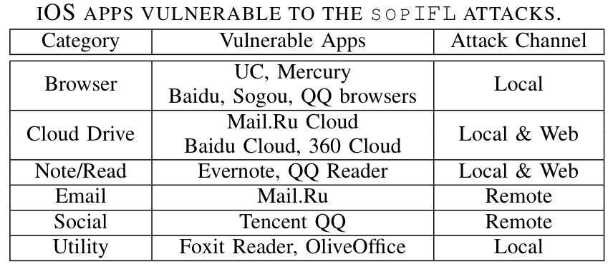
The sopIFL attacks affect many iOS apps
Causes:
  The by-default vulnerable SOPf2 on iOS
  One common app design practice in iOS apps

Slide 9
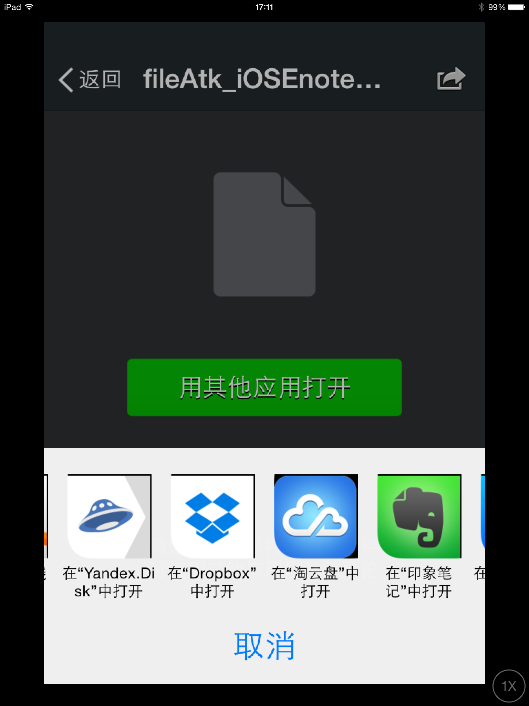
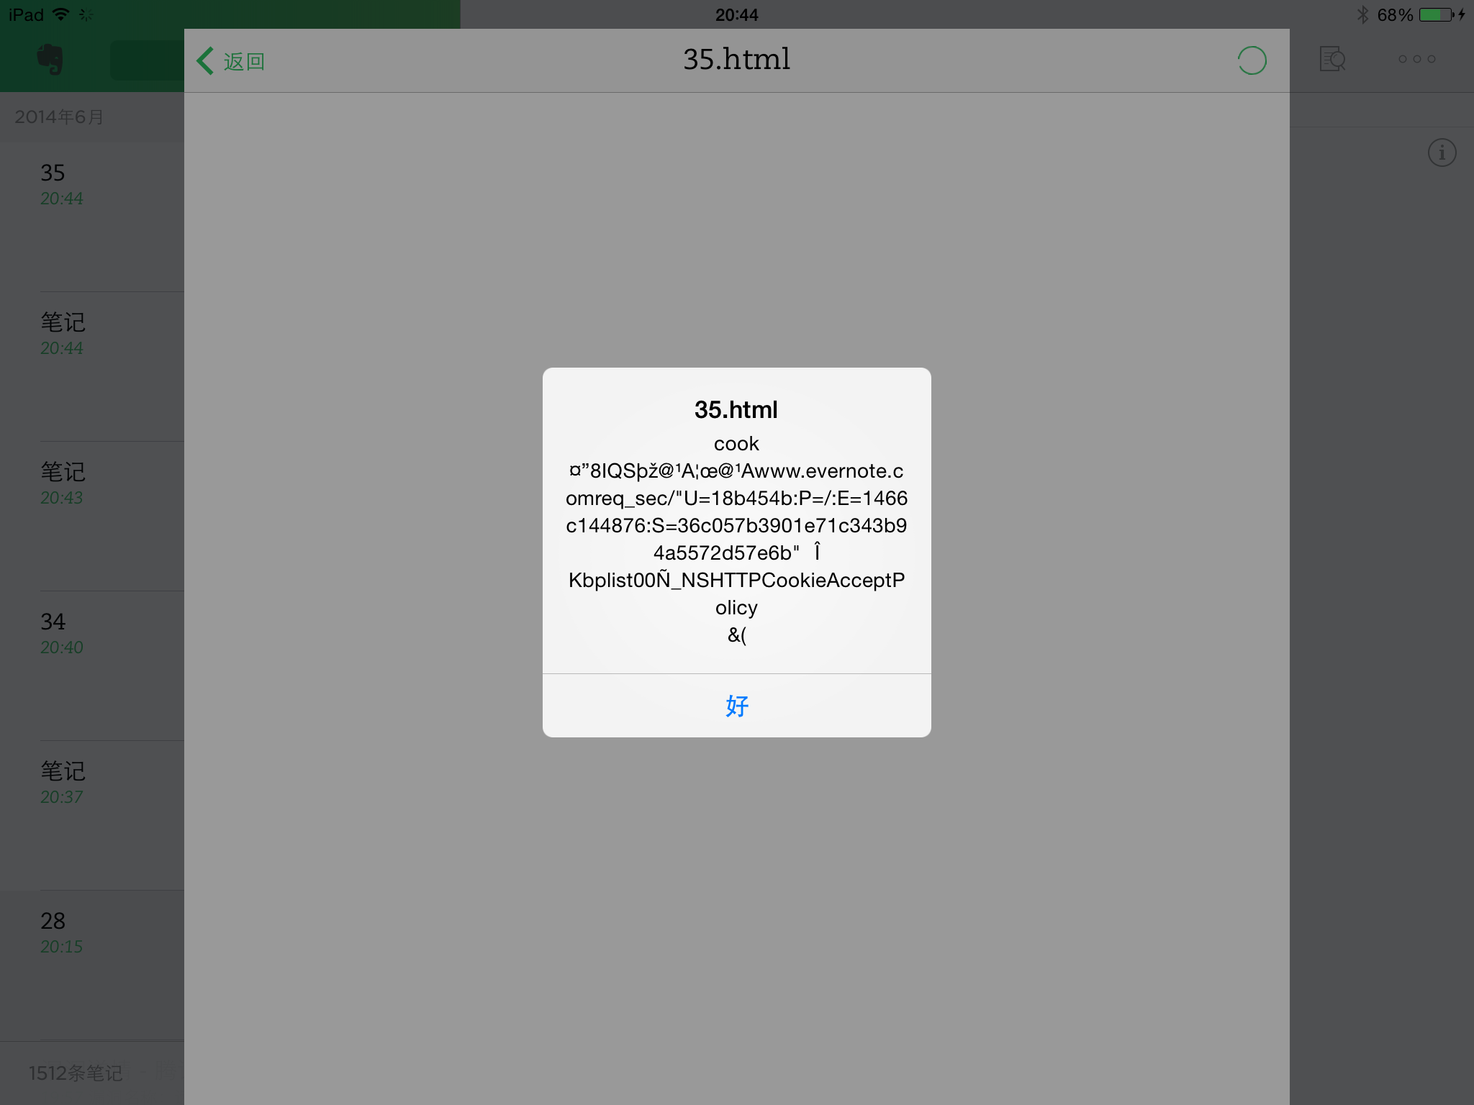
sopIFL Case Study: Evernote
iOS’s “open with” feature
Evernote’s cookie file is stolen

Slide 10
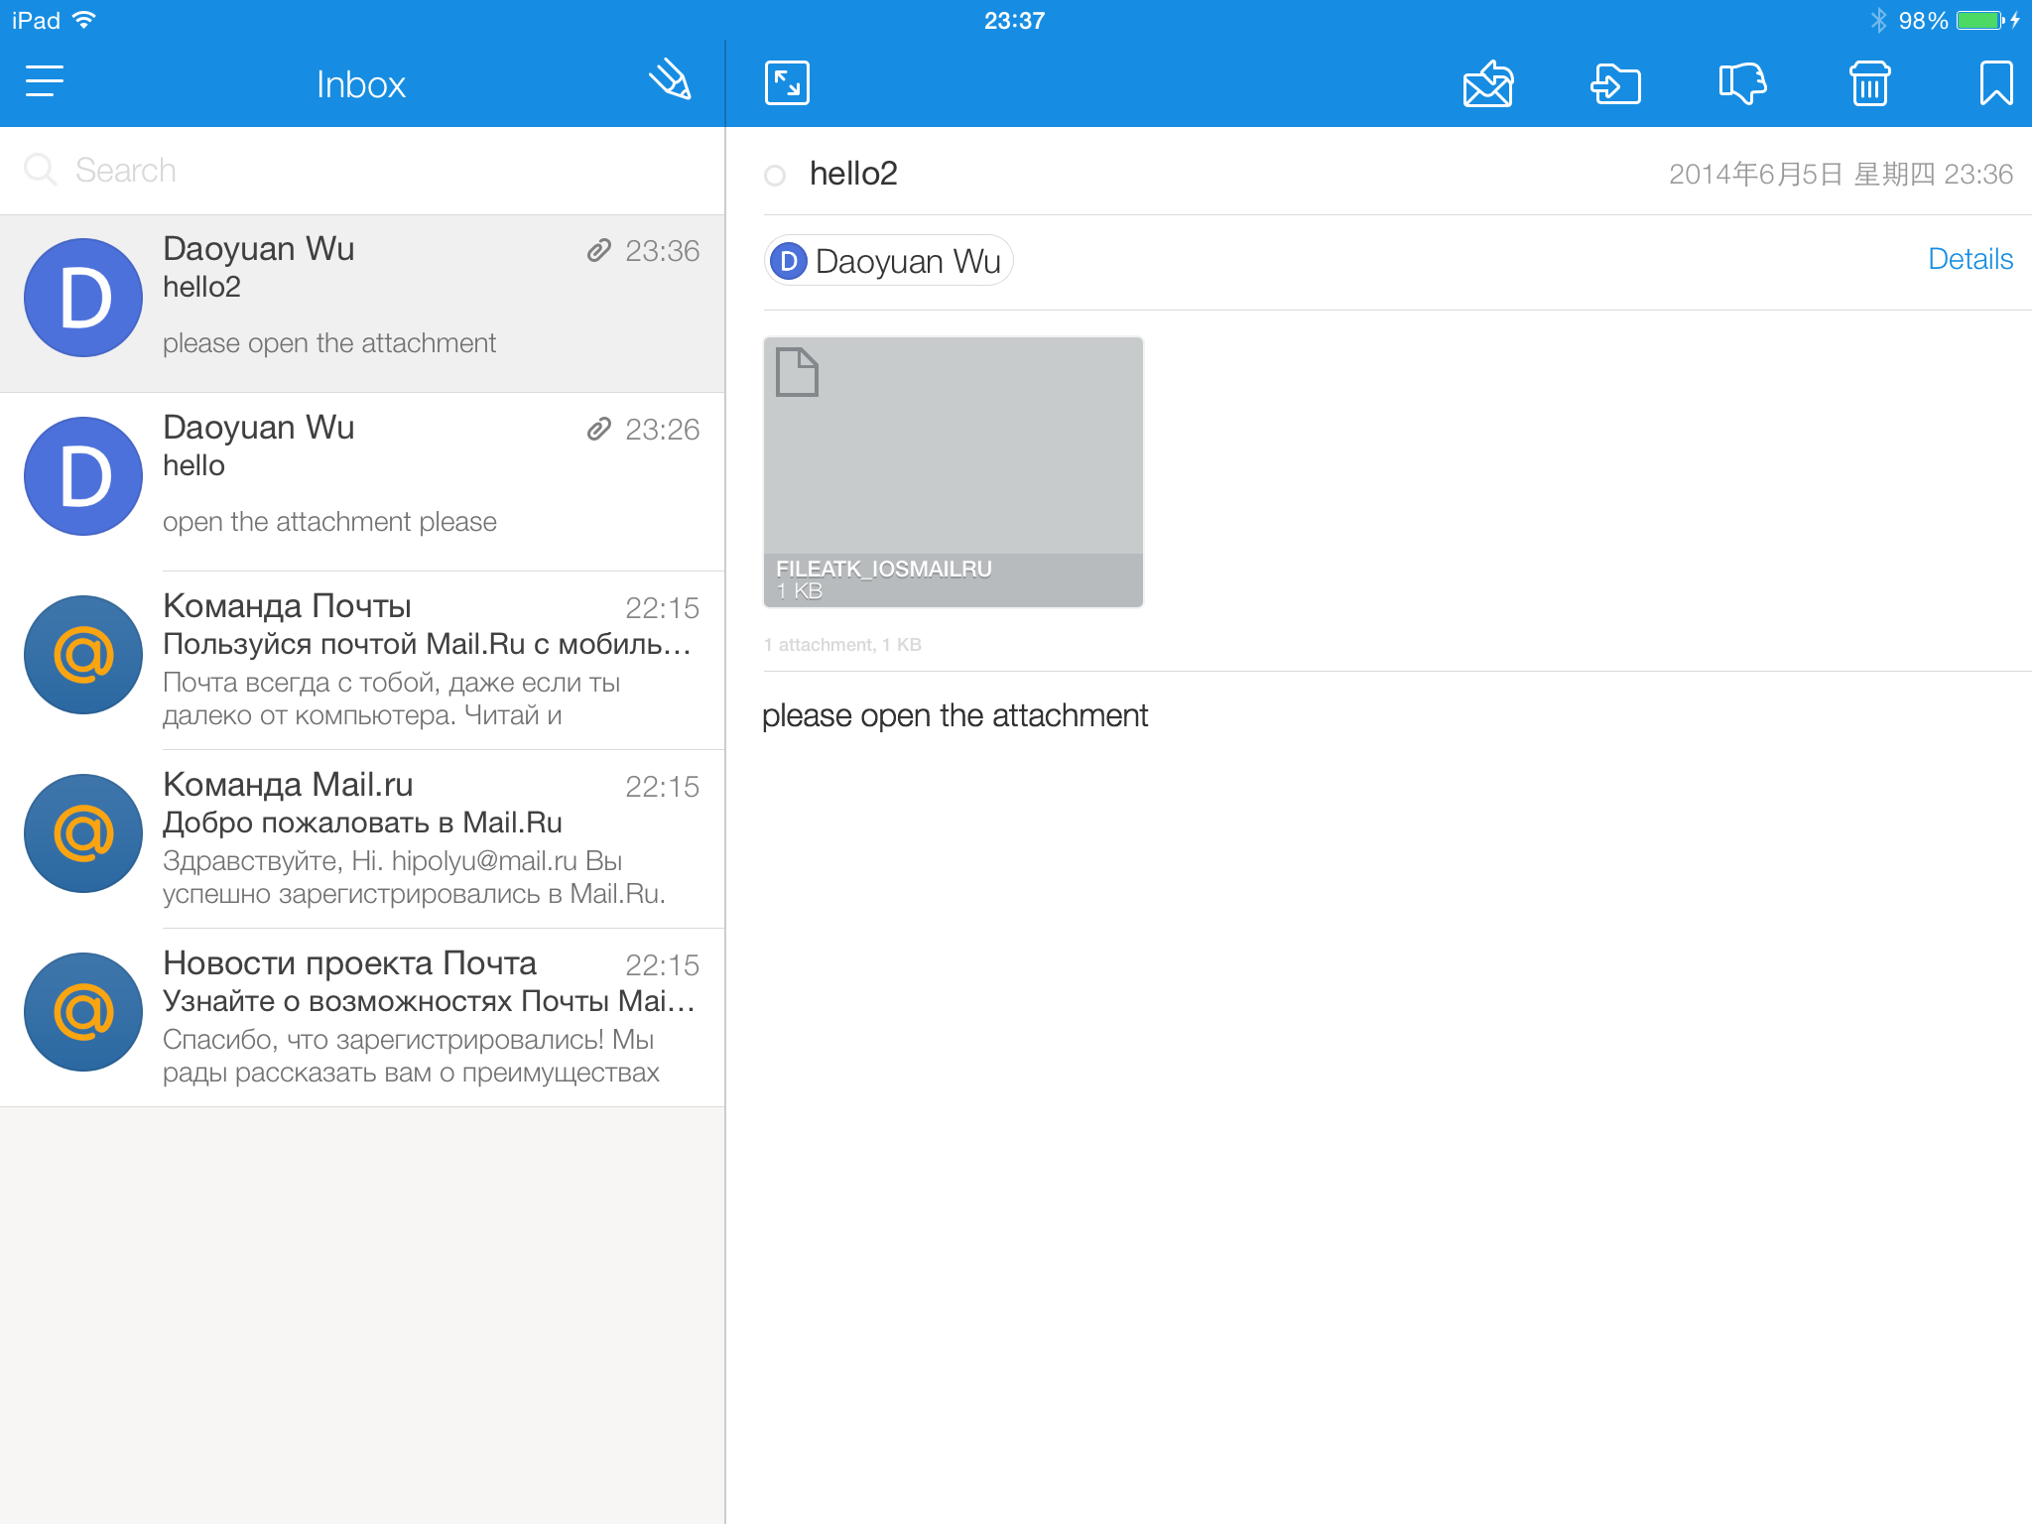
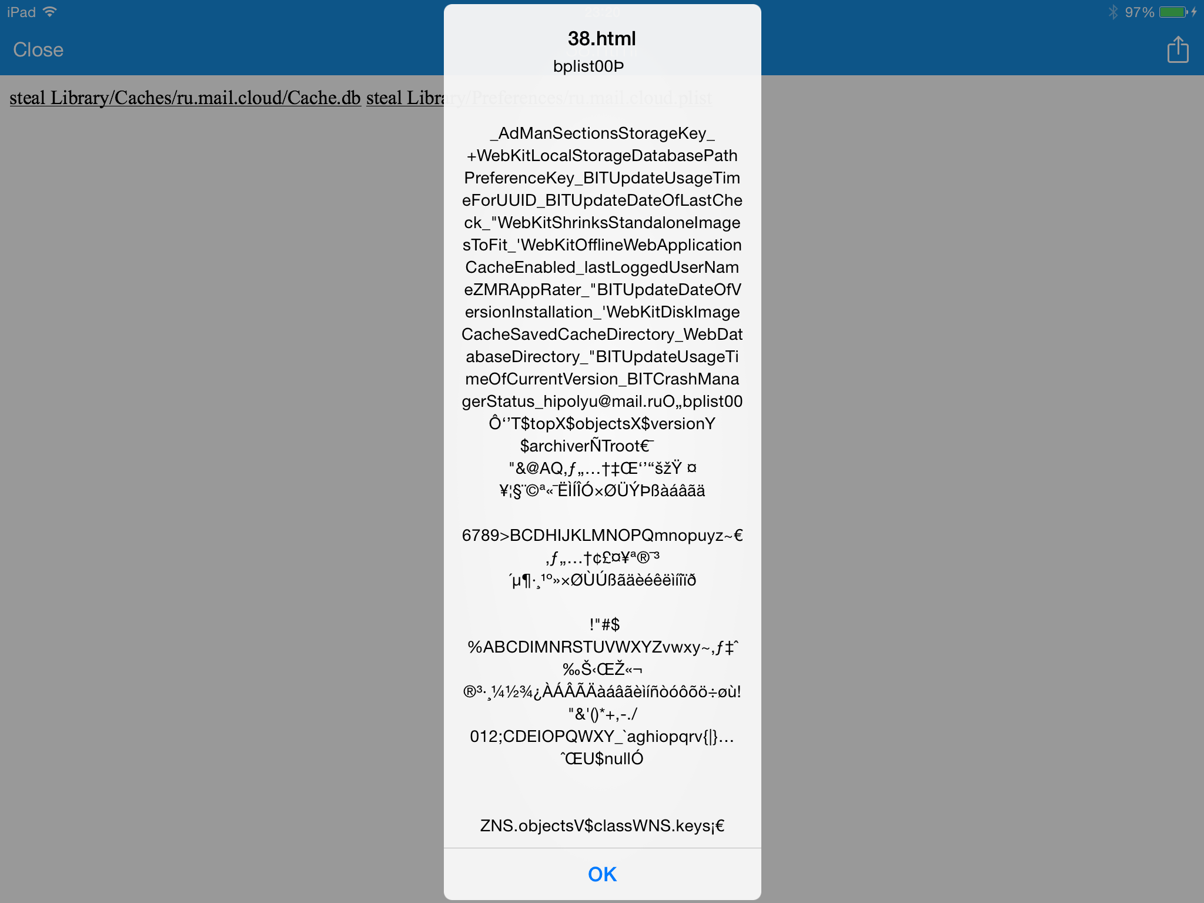
sopIFL Case Study: Mail.Ru
Just send an email with a crafted attachment!
Mail.Ru’s database file is stolen

Slide 11
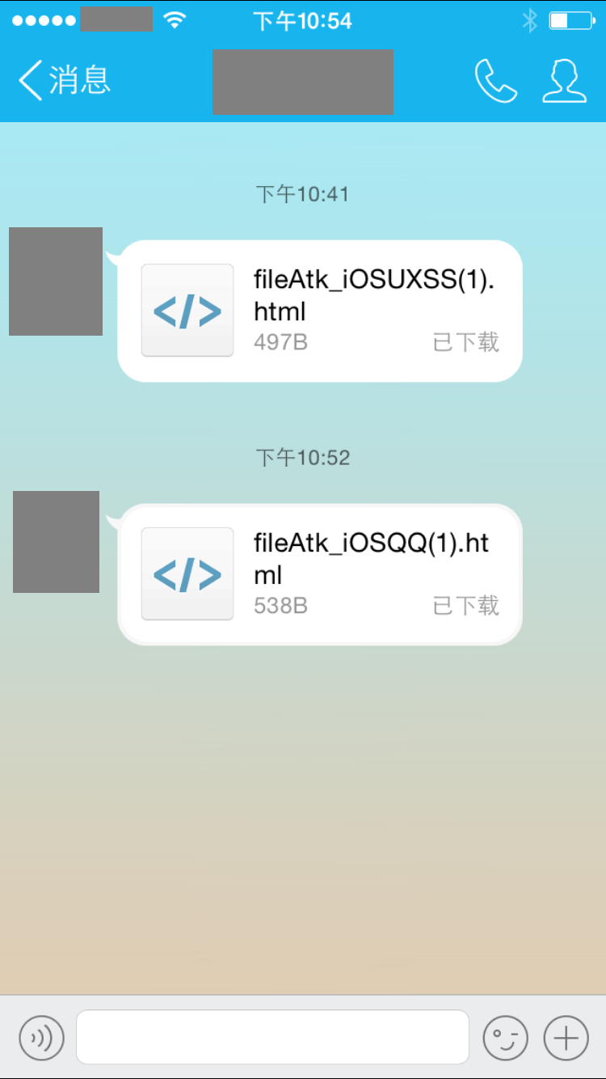
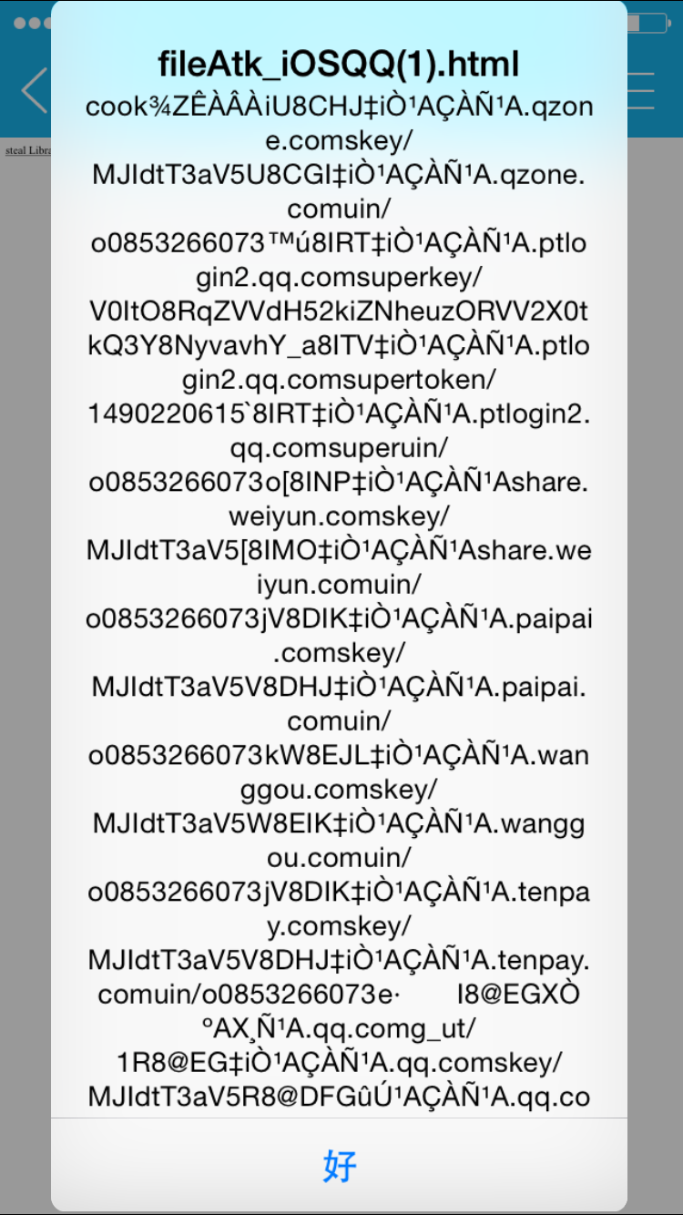
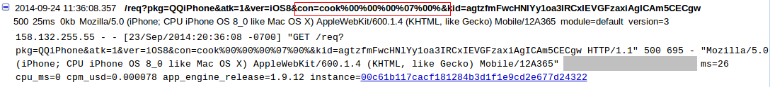
sopIFL Case Study: QQ

Slide 12
2. The aimIFL attacks
Inject and execute unauthorized JavaScripts directly on target files to steal files.
  Also leverage browsing interfaces as deputies
  But no SOP violation anymore
Two types (based on who loads the target file):
  aimIFL-1: the adversary loads
    Need to come up ways to load
  aimIFL-2: the victim app loads (as an app feature)
    No need to worry about how to load

Slide 13
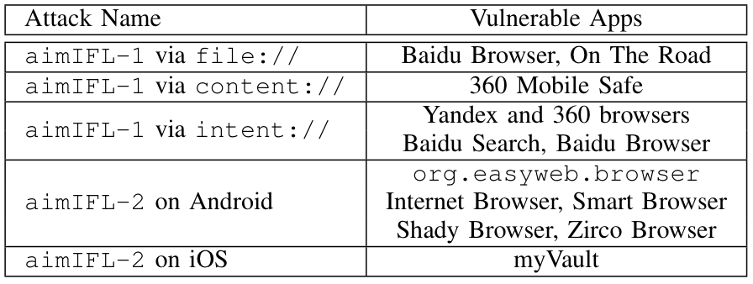
Apps vulnerable to the aimIFL attacks

Slide 14
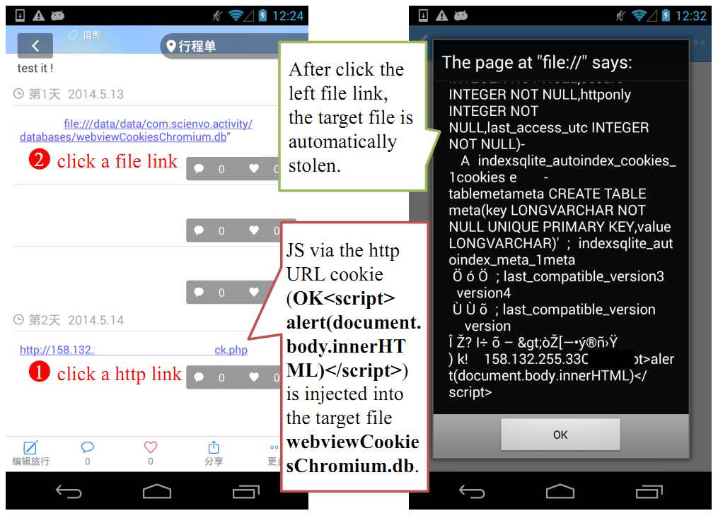
The aimIFL-1 attacks via file://

Slide 15
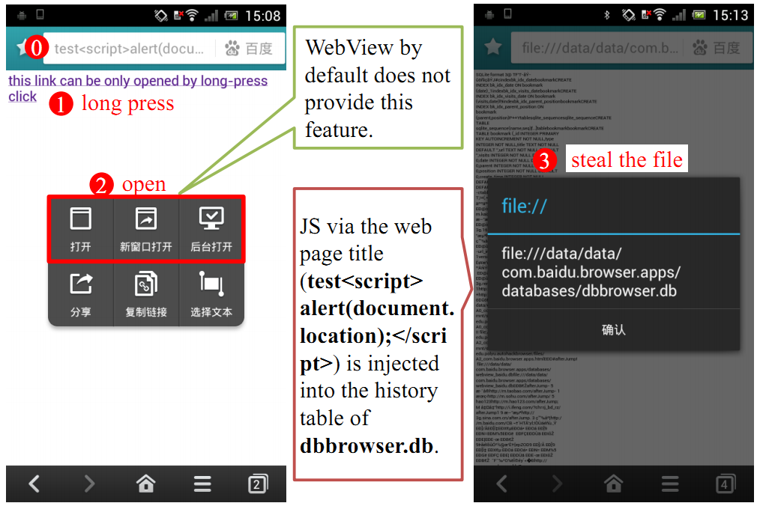
The aimIFL-1 attacks via file://
(Baidu’s most valuable vuln. report)

Slide 16
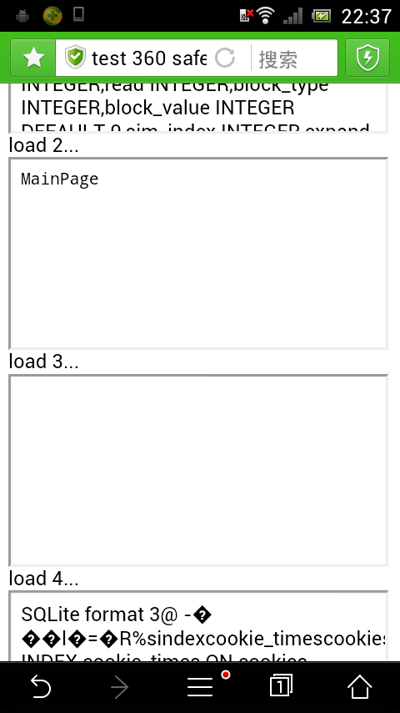
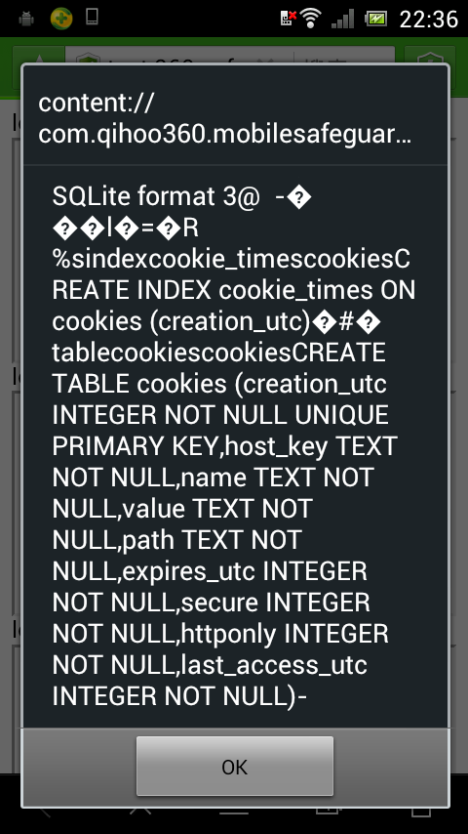
The aimIFL-1 attacks via content://
(Qihoo 360’s highest bug bounty award)

Slide 17
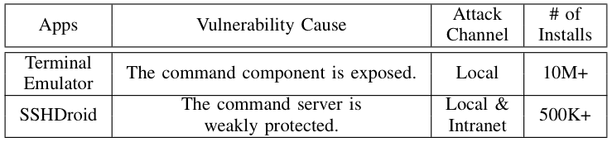
3. The cmdIFL attacks
Exploit command interpreters as deputies inside victim apps to execute unauthorized commands for file leaks

Slide 18
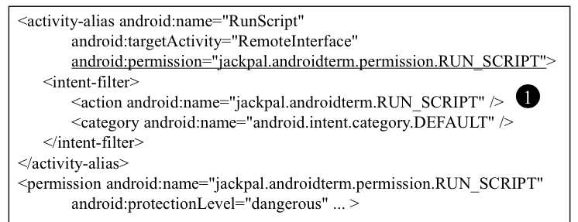
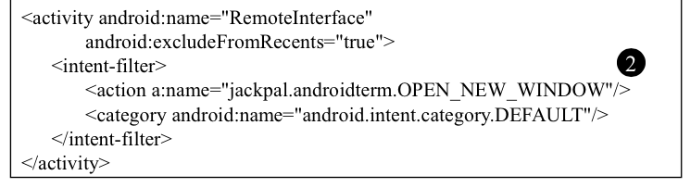
The Case of Terminal Emulator

Slide 19
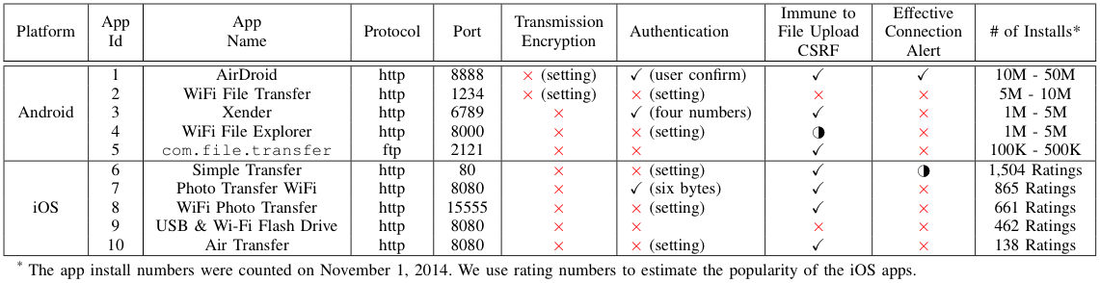
4. The serverIFL attacks
Send unauthorized file extraction requests to embedded app server deputies inside victim apps to obtain private files.

Slide 20
Android VS iOS in terms of the impact of IFL attacks
Implication 1: The common practice in iOS apps to open (untrusted) files in their own app domain could lead to more pervasive and powerful sopIFL attacks on iOS than Android.
Implication 2: The randomized app data directory on iOS makes it difficult to conduct the aimIFL-1 attacks on iOS.

Slide 21
Android VS iOS in terms of the impact of IFL attacks
Implication 3: Apple’s strict app review prevents iOS apps from executing bash commands. An adversary therefore cannot find targets to launch the cmdIFL attacks on iOS.
Implication 4: iOS generally does not allow background server behavior, which reduces the chance of the serverIFL attacks on iOS.

Slide 22
Thank you! Questions?
Daoyuan Wu from HK PolyU
daoyuan0x@gmail.com
https://daoyuan14.github.io/

